Slide 1
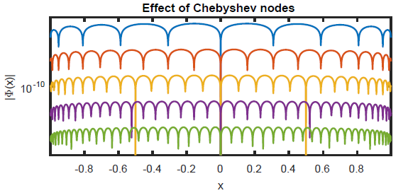
Chapter 9 Global Function Approximation

Slide 2
The interpolation problem
The interpolation problem seeks to put a function through data
The data are to be recovered exactly from the interpolation function
This is different than least squares approximation where it may be that no data points are recovered exactly
We will focus on polynomial interpolation mostly
We will also get valuable knowledge about how closely an interpolant approximates a known function

Slide 3
The interpolation problem
Chapter 5: Low degree piecewise polynomials for uniformly spaced points
We did this to avoid problems with global interpolants
In this chapter, we will change the spacing of the data to get fast and accurate interpolants
We will use them for accurate integral approximation, e.g.
In later chapters, they will help us with solving differential equations

Slide 4
Section 9.1 Polynomial Interpolation

Slide 5
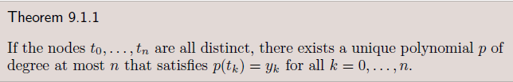
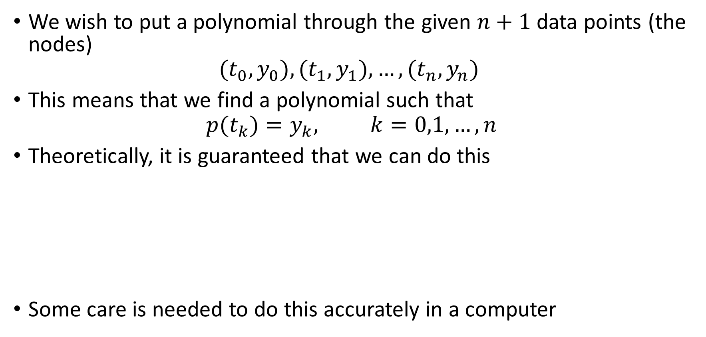
Polynomial interpolation
We wish to put a polynomial through the given $n+1$ data points (the nodes)
$$(t_{0},y_{0}),(t_{1},y_{1}),…,(t_{n},y_{n})$$
This means that we find a polynomial such that
$$p(t_{k})=y_{k}, k=0,1,…,n$$
Theoretically, it is guaranteed that we can do this
Some care is needed to do this accurately in a computer

Slide 6
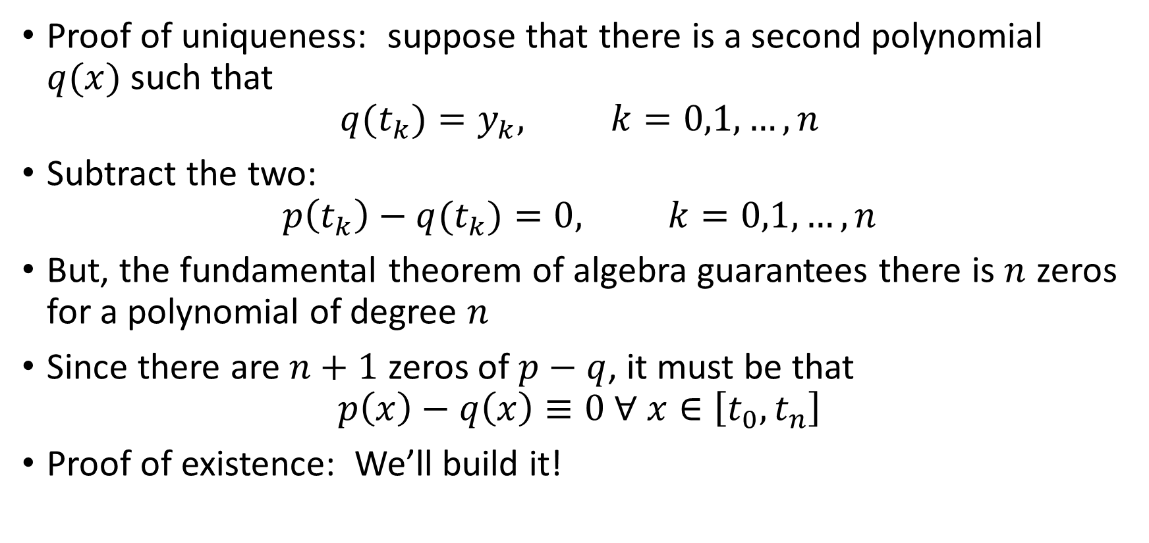
Polynomial interpolation
Proof of uniqueness: suppose that there is a second polynomial $q(x)$such that
$$q(t_{k})=y_{k}, k=0,1,…,n$$
Subtract the two:
$$p\left(t_{k}\right)−q(t_{k})=0, k=0,1,…,n$$
But, the fundamental theorem of algebra guarantees there is $n$ zeros for a polynomial of degree $n$
Since there are $n+1$ zeros of $p−q$, it must be that
$$p\left(x\right)−q\left(x\right)≡0 ∀ x∈\left[t_{0},t_{n}\right]$$
Proof of existence: We’ll build it!

Slide 7
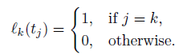
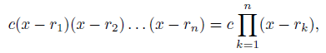
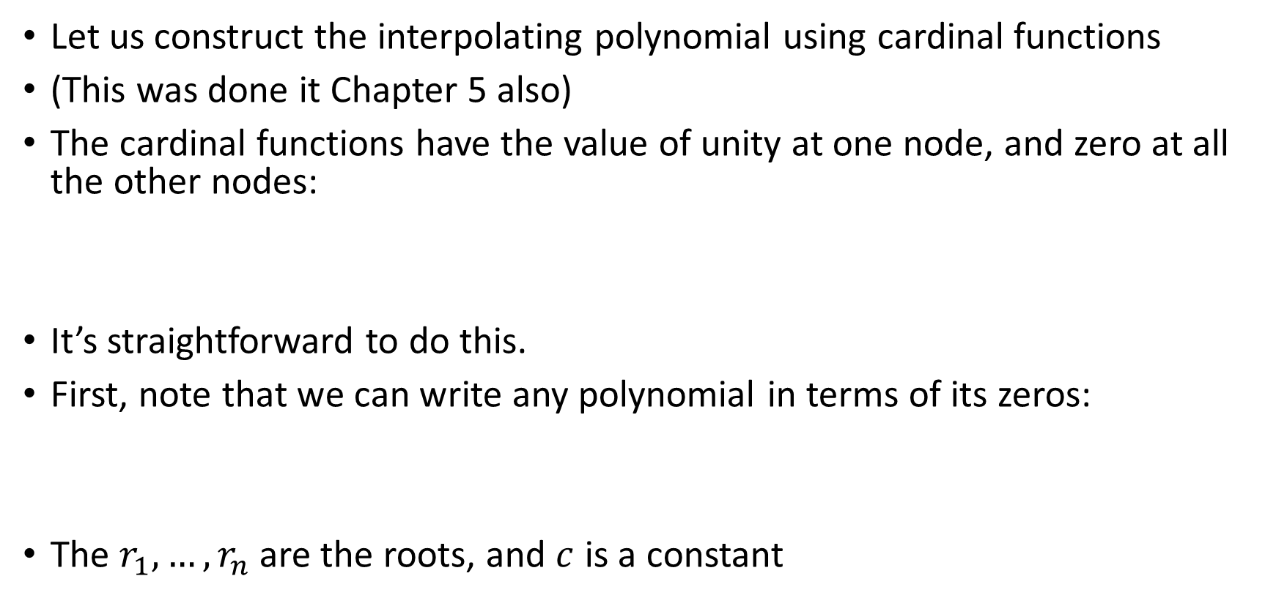
Lagrange polynomials
Let us construct the interpolating polynomial using cardinal functions
(This was done it Chapter 5 also)
The cardinal functions have the value of unity at one node, and zero at all the other nodes:
It’s straightforward to do this.
First, note that we can write any polynomial in terms of its zeros:
The $r_{1},…,r_{n}$are the roots, and $c$ is a constant

Slide 8
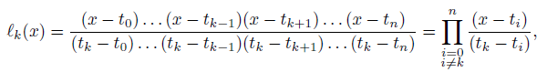
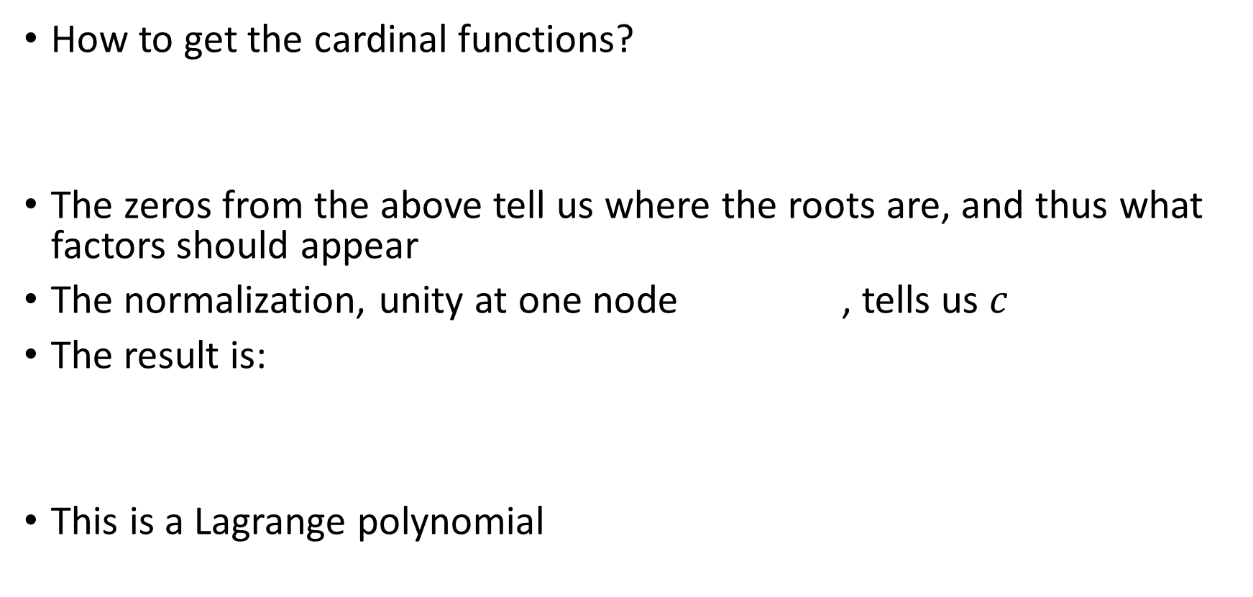
Lagrange polynomials
How to get the cardinal functions?
The zeros from the above tell us where the roots are, and thus what factors should appear
The normalization, unity at one node , tells us $c$
The result is:
This is a Lagrange polynomial

Slide 9
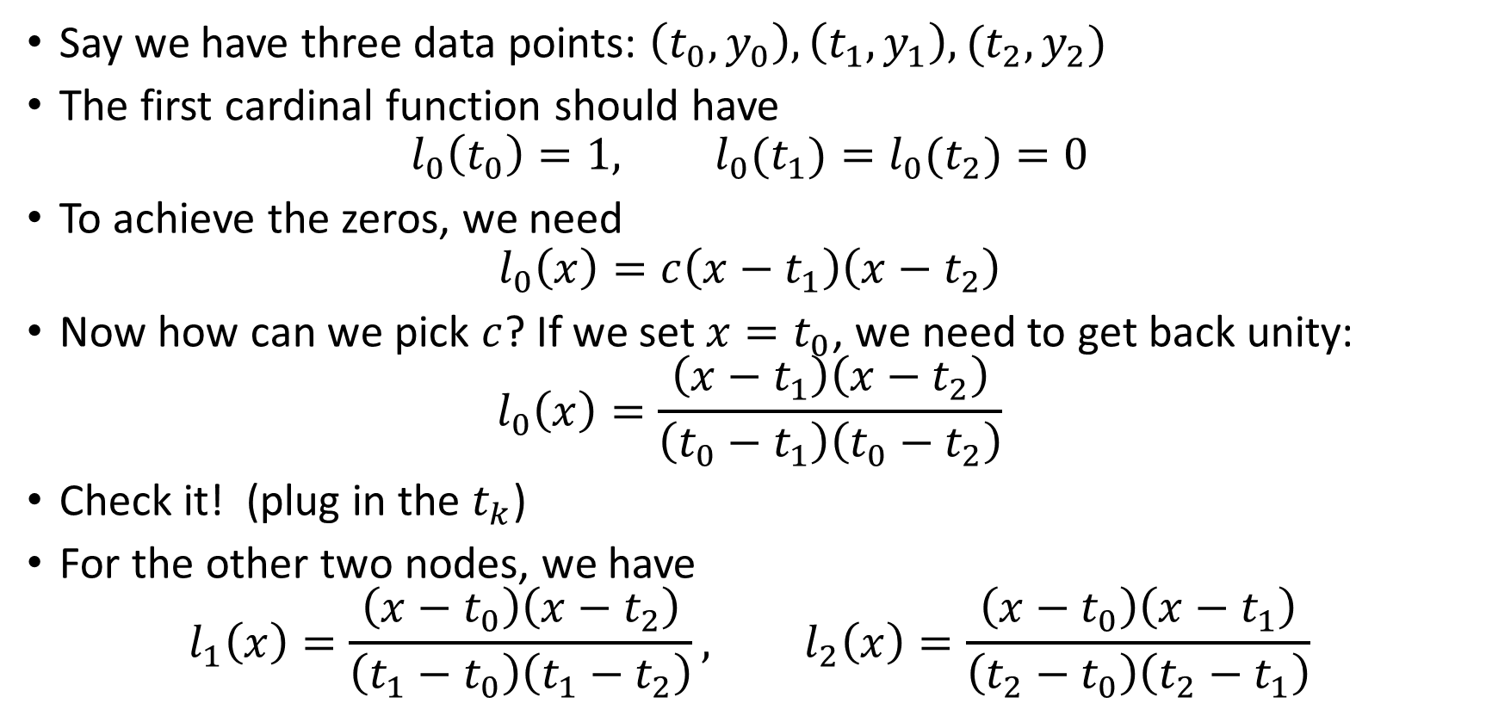
Example: Lagrange polynomials, 3 pts
Say we have three data points: $\left(t_{0},y_{0}\right),\left(t_{1},y_{1}\right),(t_{2},y_{2})$
The first cardinal function should have
$$l_{0}\left(t_{0}\right)=1, l_{0}(t_{1})=l_{0}(t_{2})=0$$
To achieve the zeros, we need
$$l_{0}\left(x\right)=c\left(x−t_{1}\right)\left(x−t_{2}\right)$$
Now how can we pick $c$? If we set $x=t_{0}$, we need to get back unity:
$$l_{0}\left(x\right)=\frac{\left(x−t_{1}\right)\left(x−t_{2}\right)}{\left(t_{0}−t_{1}\right)\left(t_{0}−t_{2}\right)}$$
Check it! (plug in the $t_{k}$)
For the other two nodes, we have
$$l_{1}\left(x\right)=\frac{\left(x−t_{0}\right)\left(x−t_{2}\right)}{\left(t_{1}−t_{0}\right)\left(t_{1}−t_{2}\right)}, l_{2}\left(x\right)=\frac{\left(x−t_{0}\right)\left(x−t_{1}\right)}{\left(t_{2}−t_{0}\right)\left(t_{2}−t_{1}\right)}$$

Slide 10
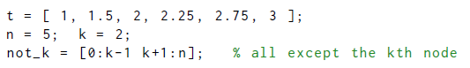
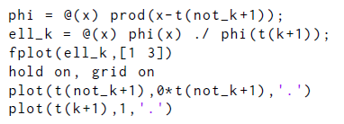
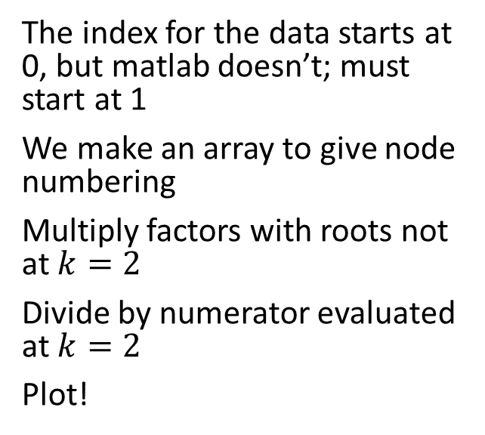
Example: Lagrange polynomial in Matlab
Consider $n=5$ and $k=2$
The index for the data starts at 0, but matlab doesn’t; must start at 1
We make an array to give node numbering
Multiply factors with roots not at $k=2$
Divide by numerator evaluated at $k=2$
Plot!

Slide 11
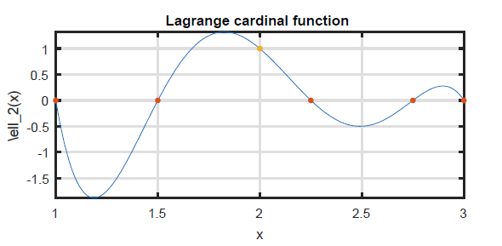
Example: Lagrange polynomial in Matlab
Consider $n=5$ and k=2
Note that the values of $l_{2}(x)$ are not trapped between 0 and 1

Slide 12
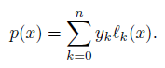
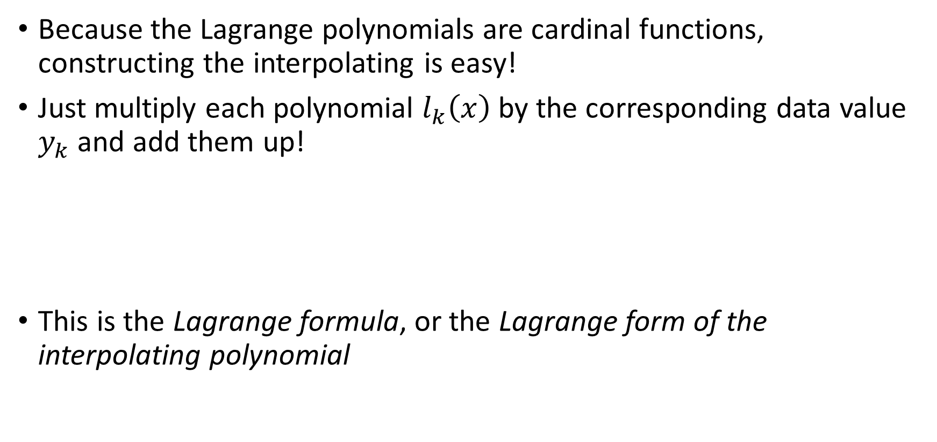
Lagrange form of the interpolating polynomial
Because the Lagrange polynomials are cardinal functions, constructing the interpolating is easy!
Just multiply each polynomial $l_{k}\left(x\right)$ by the corresponding data value $y_{k}$ and add them up!
This is the Lagrange formula, or the Lagrange form of the interpolating polynomial

Slide 13
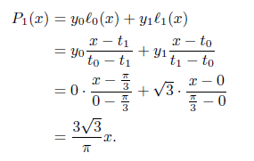
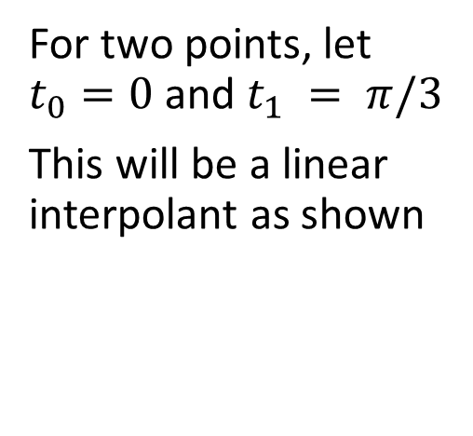
Example: Linear and quadratic
Consider replacing f(x)=tan(x) with data from two or three points
For two points, let $t_{0}=0$ and $t_{1} = π/3$
This will be a linear interpolant as shown

Slide 14
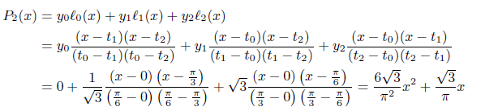
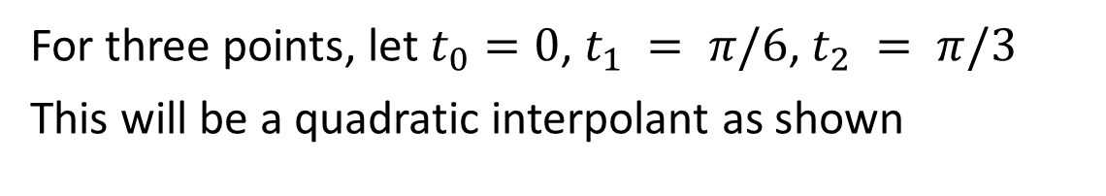
Example: Linear and quadratic
Consider replacing f(x)=tan(x) with data from two or three points
For three points, let $t_{0}=0$, $t_{1} = π/6$, $t_{2} = π/3$
This will be a quadratic interpolant as shown

Slide 15
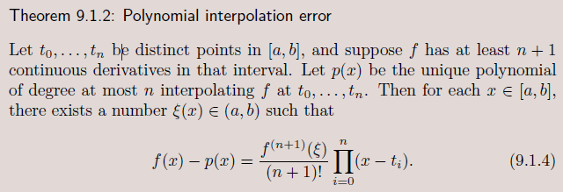
Interpolation error
Our last example replaced a trigonometric function with polynomials
How closely do those polynomials approximate the original function?
We have a powerful theorem for that

Slide 16
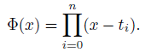
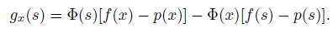
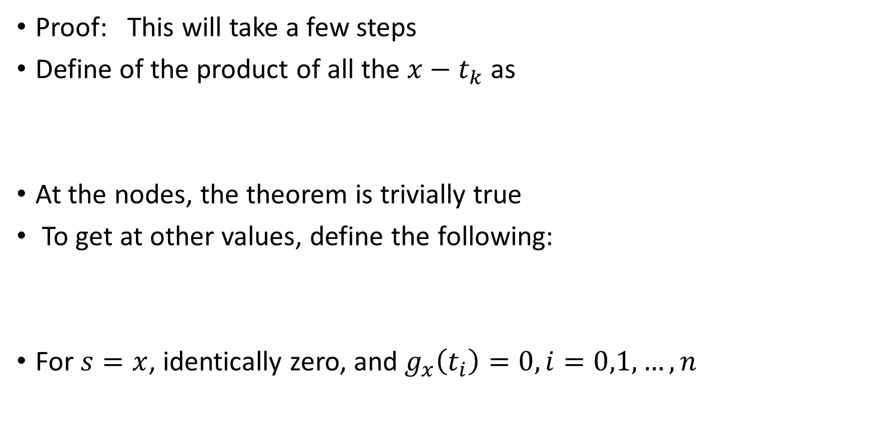
Interpolation error
Proof: This will take a few steps
Define of the product of all the $x−t_{k}$ as
At the nodes, the theorem is trivially true
To get at other values, define the following:
For $s=x$, identically zero, and $g_{x}\left(t_{i}\right)=0, i=0,1,…,n$

Slide 17
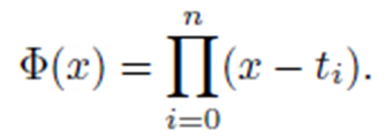
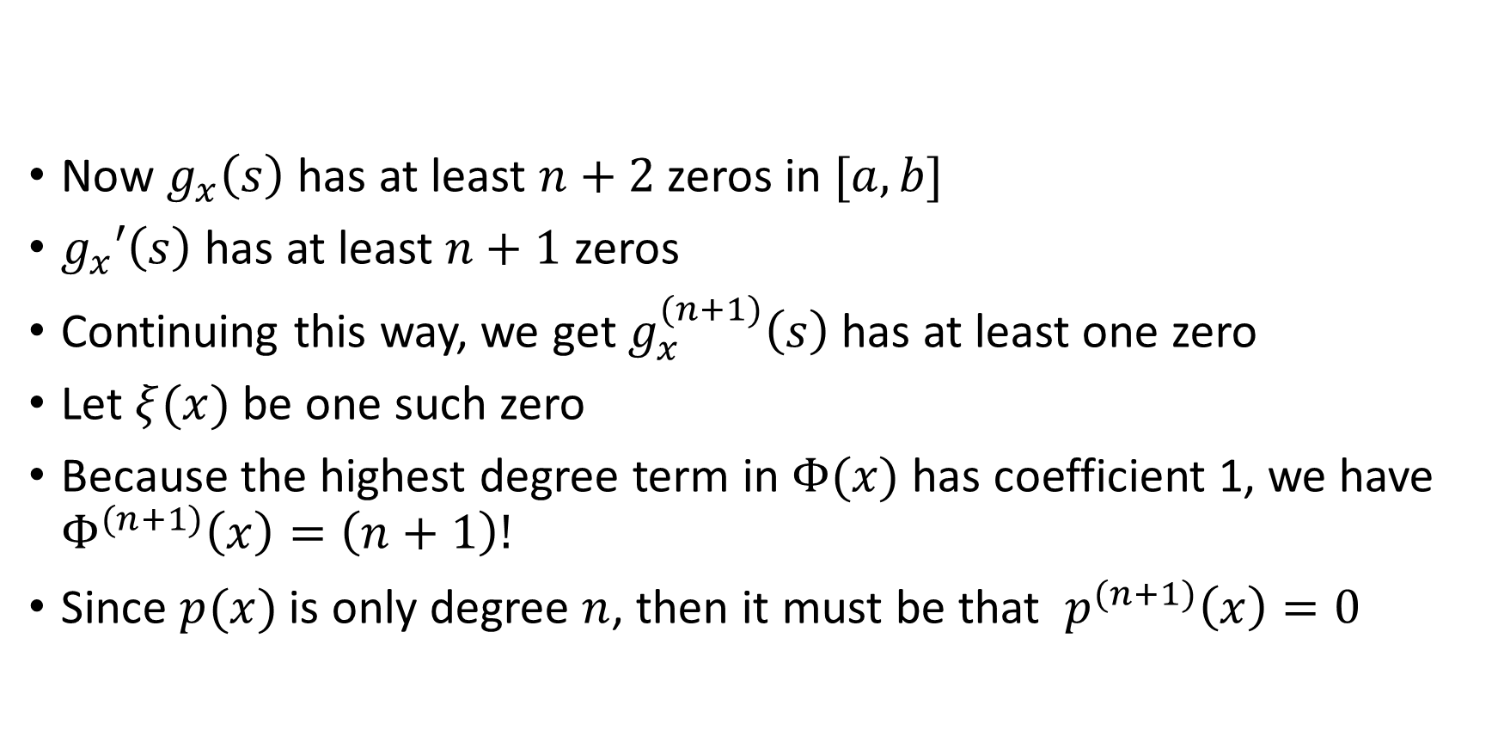
Interpolation error
Now $g_{x}\left(s\right)$ has at least $n+2$ zeros in $[a,b]$
$g_{x}′\left(s\right)$ has at least $n+1$ zeros
Continuing this way, we get $g_{x}^{(n+1)}\left(s\right)$ has at least one zero
Let $ξ(x)$ be one such zero
Because the highest degree term in $Φ(x)$ has coefficient 1, we have $Φ^{(n+1)}\left(x\right)=\left(n+1\right)!$
Since $p(x)$ is only degree $n$, then it must be that $p^{(n+1)}\left(x\right)=0$

Slide 18
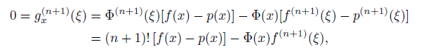
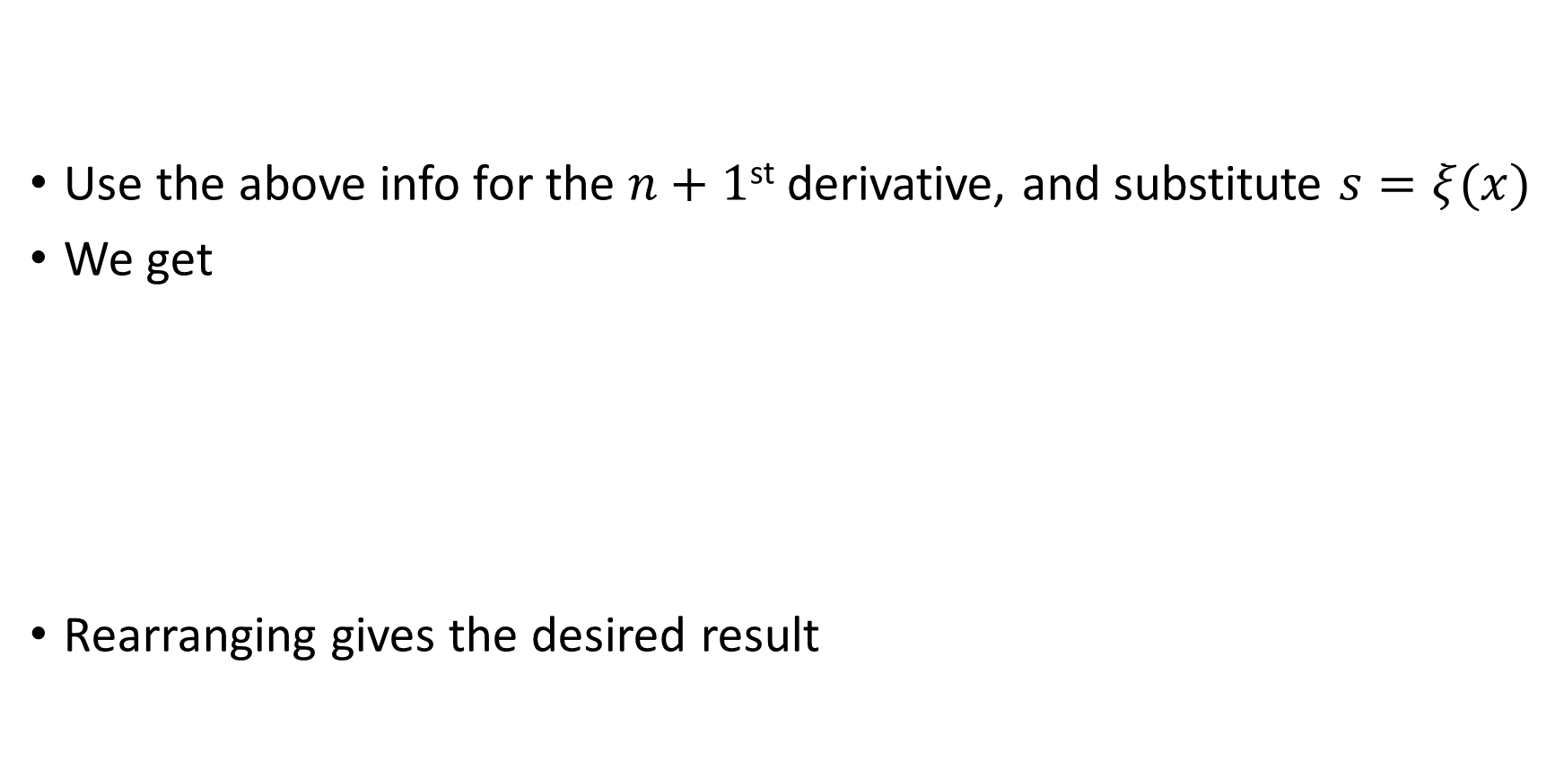
Interpolation error
Use the above info for the $n+1$^{st} derivative, and substitute $s=ξ(x)$
We get
Rearranging gives the desired result

Slide 19
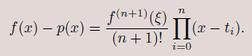
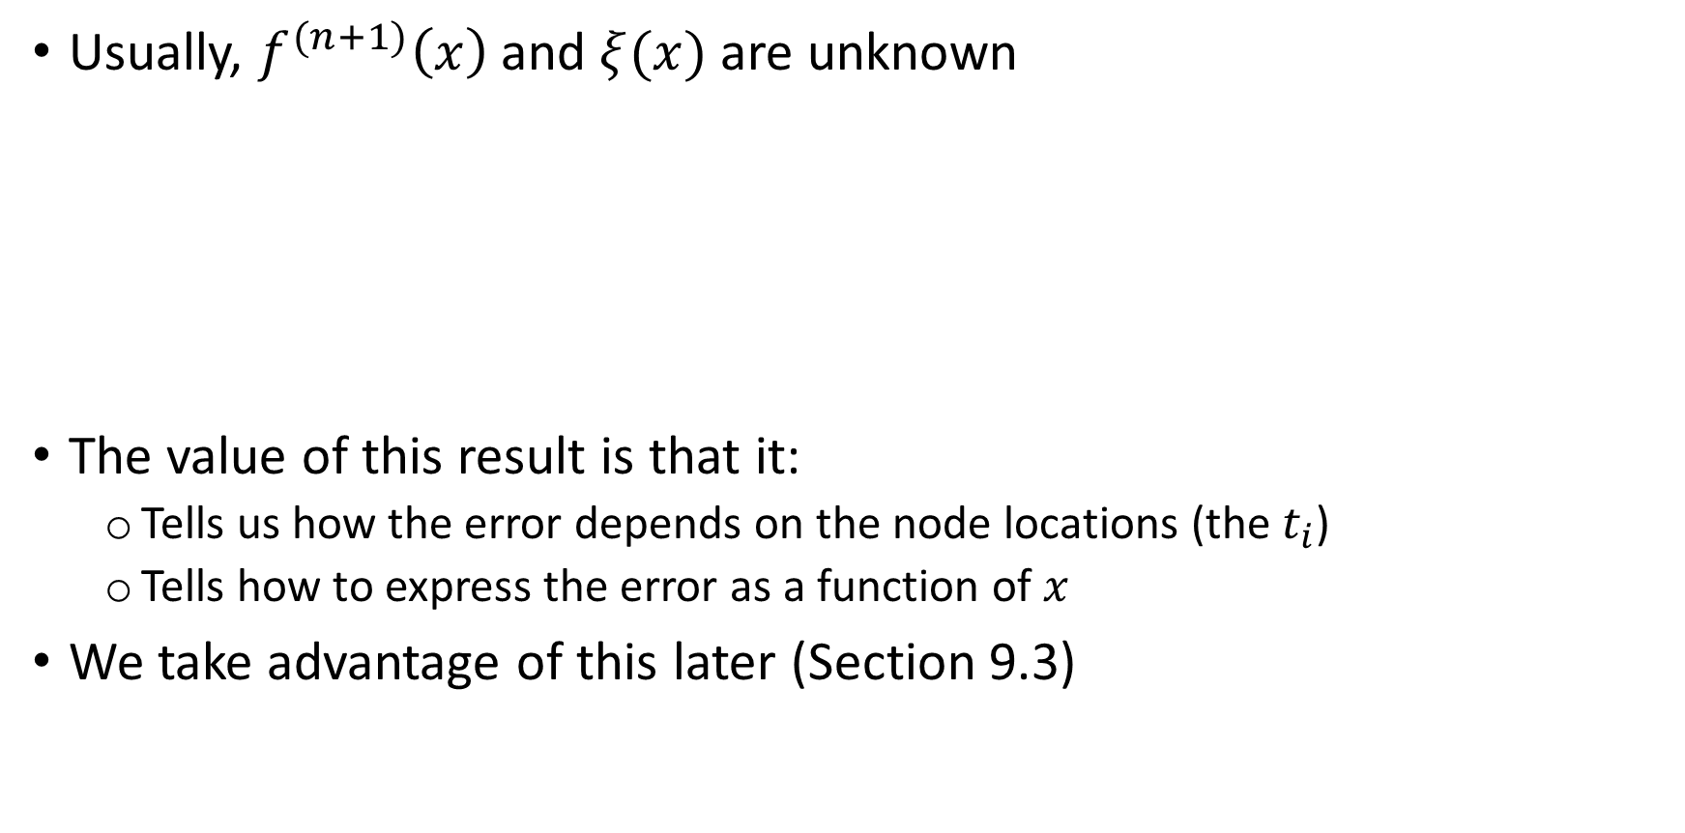
Interpolation error
Usually, $f^{(n+1)}\left(x\right)$and $ξ(x)$ are unknown
The value of this result is that it:
Tells us how the error depends on the node locations (the $t_{i}$)
Tells how to express the error as a function of $x$
We take advantage of this later (Section 9.3)

Slide 20
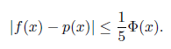
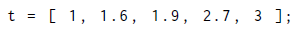
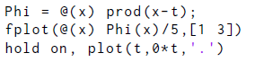
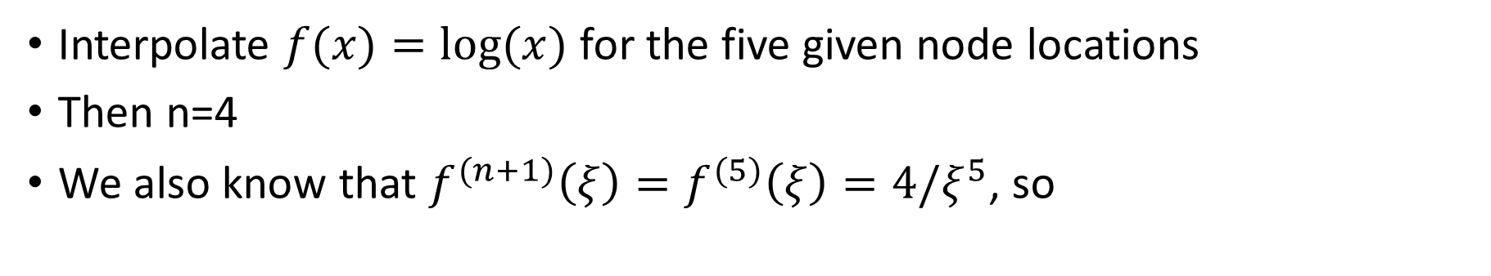
Example: error in interpolation
Interpolate $f(x)=log⁡(x)$for the five given node locations
Then n=4
We also know that $f^{(n+1)}\left(ξ\right)=f^{(5)}\left(ξ\right)=4/ξ^{5}$, so

Slide 21
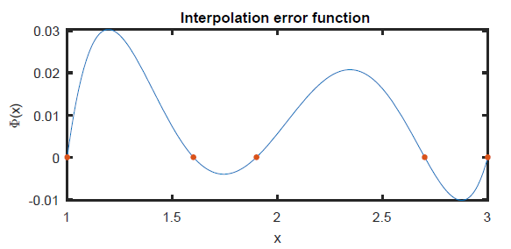
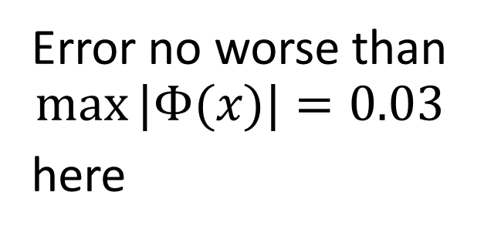
Example: error in interpolation
Error no worse than
$$max⁡|Φ(x)|=0.03$$
here

Slide 22
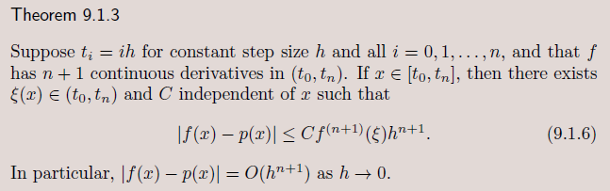
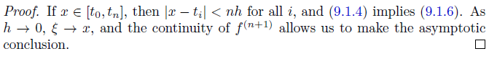
Interpolation error
We can use the last theorem for equispaced nodes

Slide 23
Interpolation error
This is all great for theory
But for computation, the Lagrange form is difficult to use: changing nodes causes lots of recomputation.
It is also unstable.
We develop a better formula for computation in the next section

Slide 24
Section 9.2 The Barycentric Formula

Slide 25
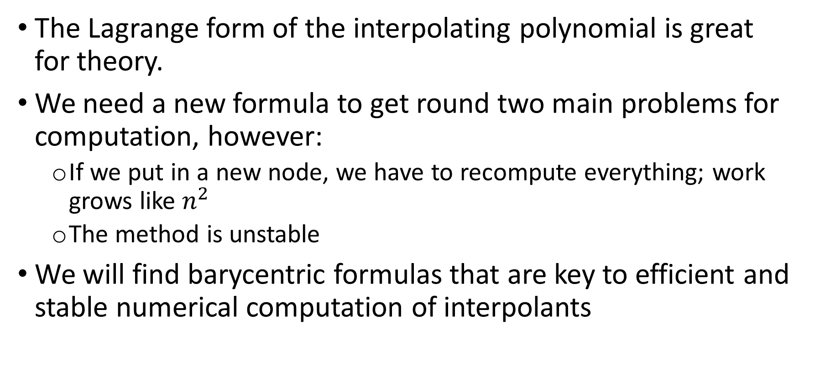
A better formula
The Lagrange form of the interpolating polynomial is great for theory.
We need a new formula to get round two main problems for computation, however:
If we put in a new node, we have to recompute everything; work grows like $n^{2}$
The method is unstable
We will find barycentric formulas that are key to efficient and stable numerical computation of interpolants

Slide 26
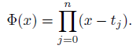
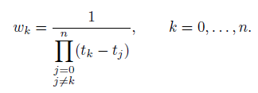
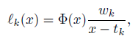
Barycentric formulas
First, define as before
Also, define the barycentric weights
Then we can rewrite the Lagrange polynomial as

Slide 27
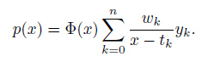
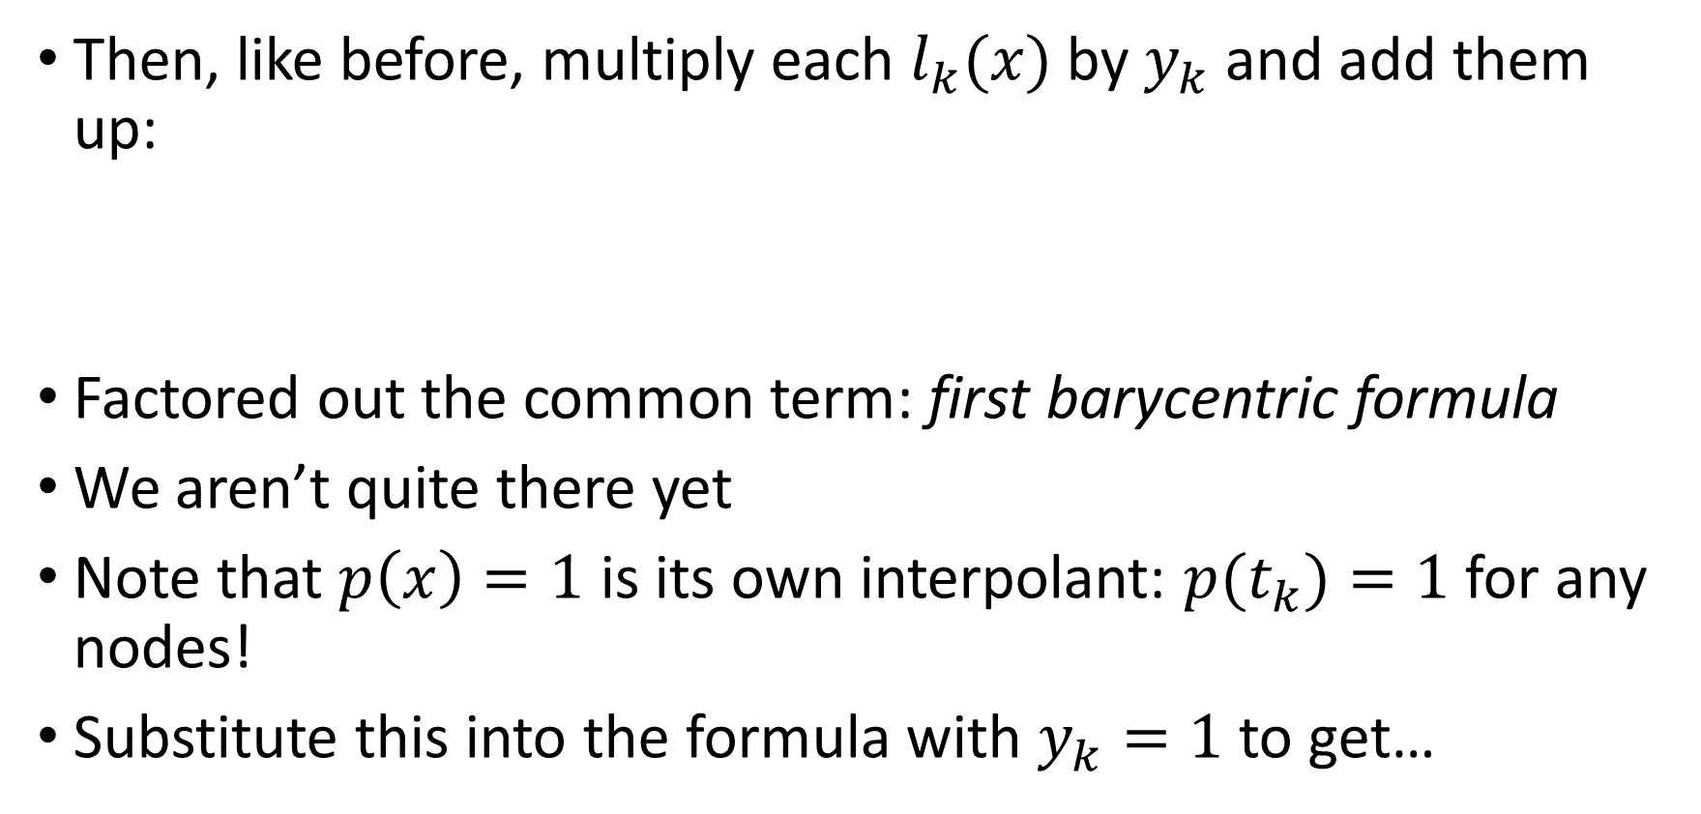
Barycentric formulas
Then, like before, multiply each $l_{k}(x)$ by $y_{k}$ and add them up:
Factored out the common term: first barycentric formula
We aren’t quite there yet
Note that $p\left(x\right)=1$ is its own interpolant: $p(t_{k})=1$for any nodes!
Substitute this into the formula with $y_{k}=1$ to get…

Slide 28
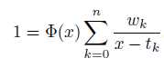
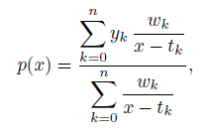
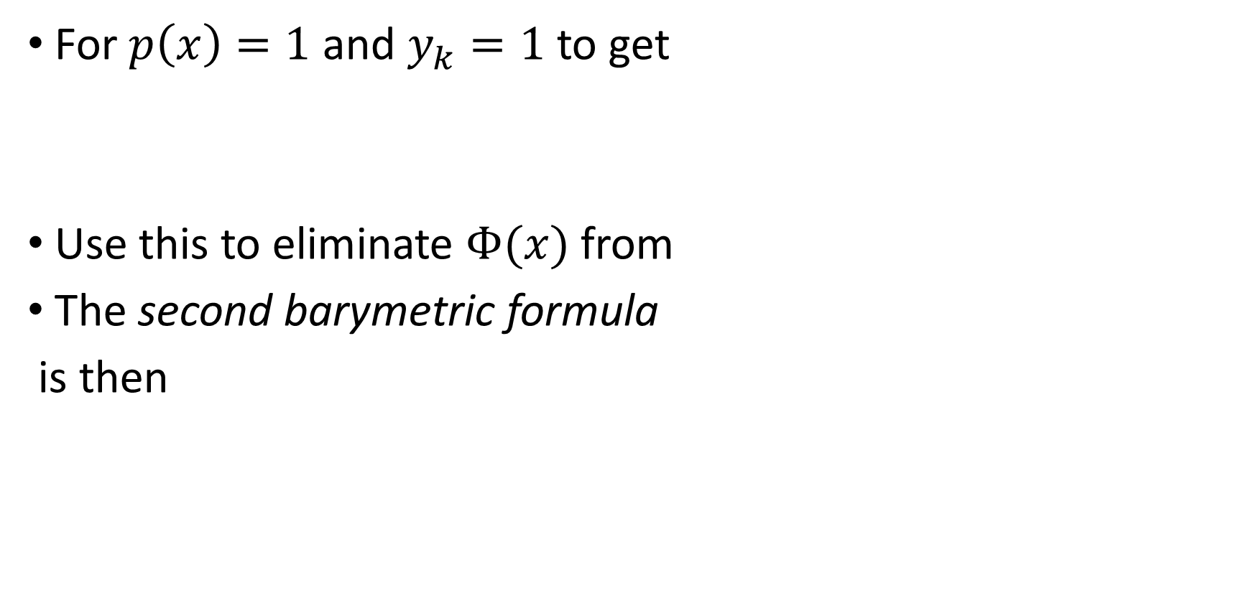
Barycentric formulas
For $p\left(x\right)=1$ and $y_{k}=1$ to get
Use this to eliminate $Φ(x)$ from
The second barymetric formula
is then

Slide 29

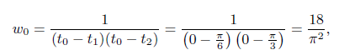
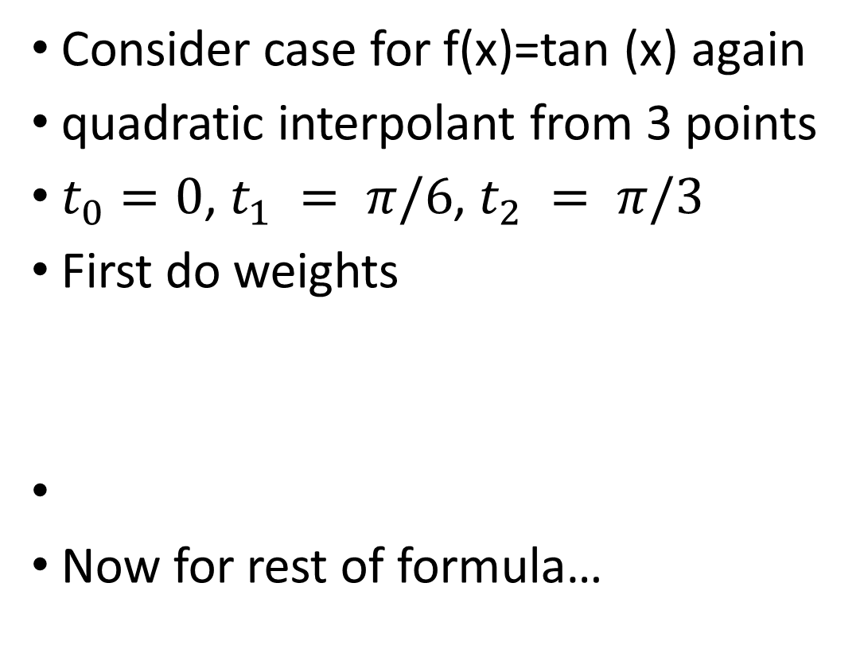
Example: creating barycentric formulas
Consider case for f(x)=tan (x) again
quadratic interpolant from 3 points
$t_{0}=0$, $t_{1} = π/6$, $t_{2} = π/3$
First do weights
Now for rest of formula…

Slide 30
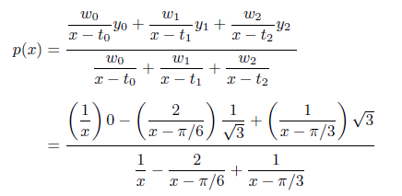

Example: creating barycentric formulas
Using the weights and nodes:
Note that we divided out the common factor of $18/π^{2}$
Further algebra would recover the Lagrange form.

Slide 31

Barycentric formula
Evaluating the whole formula takes $O(n^{2})$ flops
The formula for the weights depends only on the nodes
Once they are computed, different $y_{k}$ need only $O(n)$ flops
We need a new formula to get round two main problems for computation, however:
We will find barycentric formulas that are key to efficient and stable numerical computation of interpolants

Slide 32


Barycentric formula: function polyinterp
First evaluate the weights $w_{k}$
Actually the reciprocal of the weights is computed: $ω_{k}=w_{k}^{−1}$
The weights are rescaled to avoid really large or small weights
Start with singleton node $\{t_{0}\}$and $w_{0}=1$, and recursivedly compute the rest via
Reciprocate the $ω_{k}$ after computing them all
Sum the numerator and denominator and divide
Fix any NaNs: L’Hôpital’s rule!

Slide 33


Slide 34

Function 9.2.1 (cont’d)

Slide 35

Example: creating barycentric formulas
Compare n=3 and n=6 interpolants for a function

Slide 36

Example: creating barycentric formulas
Compare n= and n=7 interpolants for a function

Slide 37

Barycentric formula: stability
Because the weights $w_{k}$ have a factor $1/(x−t_{i})$, you would think that would cause problems
The function had to fix any NaNs: L’Hôpital’s rule!
It turns out to not cause any problems in practice because both numerator and denominator have such factors
More in the coming sections…

Slide 38
Section 9.3 Stability of Polynomial Interpolation

Slide 39
Stability of polynomial interpolation
We have what is claimed is a stable formula for interpolation
What we mean is this case is that for a fixed number of nodes, we can move them around and the formula doesn’t get excessive error from that
But, it can be that a stable formula is susceptible to problems with interpolation itself
Let’s see an example…

Slide 40



Example: increasing equispaced nodes
Let’s revisit $f\left(x\right)=\sin\left(\exp\left(2x\right)\right)$
We already interpolated with a few nodes
What happens for equally spaced points and increasing $n$?

Slide 41

Example: increasing equispaced nodes
n=5 to 60 nodes
Compute the error at each n
May we have the results plot please?

Slide 42


Example: increasing equispaced nodes
The error decreases as $O(K^{−n})$ for some constant $K$ until n=30 (exponentially)
Then the error increases exponentially!
May we have the results plot please?

Slide 43


Stability of polynomial interpolation
Why does the error grow?
The error is given by
We claim that it’s the uniform spacing of the points t_i that causes the problem
To see this we can study $Φ(x)$

Slide 44



Example: Increasing equispaced nodes
Plot $Φ(x)$ on [-1,1]
Change n from 10 to 50 in steps of 10
Does it decrease?
If so, it it uniform in the interval?

Slide 45


Example: increasing equispaced nodes
At any fixed $x$, the function decreases exponentially
But, the ends are exponentially larger than the middle
This nonuniformity in $x$ is what destroys the convergence for $n→∞$

Slide 46

Example: Runge function
This innocent looking function may not be so easy to interpolate
It is called a Runge function, after a German mathematician

Slide 47

Example: Runge function
Error is improving for these small values of n
But not uniformly

Slide 48

Example: Runge function
Error is as good as can be in the middle
But not so at the ends, even grows!

Slide 49
Instability: Runge phenomenon
Example 9.3.3 demonstrates the Runge phenomenon
We may think that increasing n should help: but it doesn’t!
The Runge phenomenon is an instability in the abstract mapping from a function to its polynomial interpolant, manifested when the nodes of the interpolant are equally spaced and the degree of the polynomial increases.
This is from trying to do interpolation this way, not because of the formula
We can even out the error by being clever about where we place the nodes

Slide 50


Chebyshev nodes
Consider this (important) node distribution
These locations are called Chebyshev points of the second kind, or sometimes Chebyshev extreme points
These are the $x$ locations of uniformly spaced points around the upper half of the unit circle in the $\left(x,y\right)$-plane

Slide 51


Example: Runge function with Chebyshev points
Plot $Φ(x)$ on [-1,1] again
Note node locations are now Cheb 2nd kind points

Slide 52


Example: Runge function with Chebyshev points
$Φ(x)$ is decreasing all over [-1,1] now!
Woohoo!
We did pay a small price with slower rate of convergence in the middle

Slide 53

Example: Repeat 9.3.3 with Chebyshev points
Runge function again
n=16 and 40 nodes are near machine precision on entire domain!

Slide 54


Chebyshev points
We now have a convergence over the whole domain
It also turns out that the barycentric weights for the Chebyshev points are simple:
And these are used with

Slide 55


Spectral convergence
Let $n →∞$and use polynomial interpolation on Chebyshev nodes
Then, the convergence rate is exponential in $n$.
Also called spectral convergence or geometric

Slide 56

Spectral convergence
Spectral convergence:
$O(K^{−n})$ for some constant $K>1$ for $n →∞$
Power increases with $n$
Linear on a semilog plot
Linear convergence:
$O(n^{−p})$ for some constant $p>1$ for $n →∞$
Factor times $n$ to reduce error by constant factor
Linear on a log-log plot
Spectral convergence: $n=30, K=2$, error $≈2^{−30}$
Linear convergence: $n=30, p=2$, error $≈{30}^{−2}$

Slide 57
Section 9.4 Orthogonal Polynomials

Slide 58
Orthogonal polynomials
We can do more than interpolation with polynomials for global approximation of functions
In chapter 3, we saw how to find least squares fits to data with polynomials
We can extend the idea to fitting functions

Slide 59





Example: fit linear function to $e^{x}$
Using Vandermonde approach
V has columns with $t^{0}$ and $t^{1}$
Backslash solves rectangular system for least square fit

Slide 60



Example: fit linear function to $e^{x}$
Nothing special about 40 points
More points similar
Approaching a limit?

Slide 61

Orthogonal polynomials
To generalize further, we need to extend some ideas from linear algebra (finite dimensional definitions) to continuous functions
Let S be the set of continuous real-valued functions on [-1,1]
For two vectors, we know that the inner product is
$$u^{T}v=\sum_{i=1}^{n}{u_{i}v_{i}}$$
For functions, we can define the inner product of $f(x)$ and $g(x)$ in S as
$$\left\langle f,g\right\rangle =\int_{−1}^{1}{f\left(x\right)g\left(x\right)dx}$$
The inner product creates a real number from any pair of functions in S

Slide 62

Orthogonal polynomials
We can now refer to S as an inner product space
We can extend some familiar concepts to S, such as the 2-norm:
$${\left|\left|f\right|\right|}_{2}^{2}=\left\langle f,f\right\rangle =\int_{−1}^{1}{f^{2}\left(x\right)dx}$$
And, orthogonality: if f and g are orthogonal, then
$$\left\langle f,g\right\rangle =\int_{−1}^{1}{f\left(x\right)g\left(x\right)dx}=0$$
As with vectors, orthogonality may occur when neither function is identically zero

Slide 63

Orthogonal polynomials
Ok, we have linked vectors and continuous functions
How do we do this with matrices?
We have considered matrices as a collection of columns
Recall that for interpolation, we could use the Vandermonde approach (Section 2.1): solve the square system $Vc=y$ for the coefficients $c$ given function values $y$ at nodes $t$
The polynomial interpolation problem was to find the $c_{i}$ such that
$$y=Vc=c_{0}v_{0}+c_{1}v_{1}+…+c_{n}v_{n}$$
The columns of $V$ came from the monomials evaluated at the independent variable values: the $i$th row of $v_{j}$ is $t_{i}^{j}$,

Slide 64

Orthogonal polynomials
For the least squares problem, solve the rectangular system $Vc=y$ for the coefficients $c$ given function values $y$ at nodes $t$
In this case, there are more rows than columns: “too many equations”
Alternatively, we could say that too many rows is too many nodes, and not enough columns is not enough monomial terms
Let’s take this view a step farther

Slide 65



Orthogonal polynomials
Consider our linear combination
$$c_{0}v_{0}+c_{1}v_{1}+…+c_{n}v_{n}$$
differently
Now consider a linear combo where the columns are actually monomial functions in S:
The underline emphasizes the connection to S
Now define the quasimatrix
The quasimatrix product $Vc$ is interpreted as above

Slide 66


Quasimatrices
We can also define an inner product with the quasimatrix as follows:
We can also define the matrix operation $W =V^{T}V$as the $(n+1)×(n+1)$matrix having entries $W_ij=\left\langle x^{i},x^{j}\right\rangle$
The entries are inner products of different monomials (columns)
$$W_{ij}=\left\langle x^{i},x^{j}\right\rangle =\int_{−1}^{1}{x^{i}x^{j}}dx$$

Slide 67


Quasimatrices
We can use other functions besides monomials in the columns
Let $f_{1}(x), f_{2}(x),…,f_{k}(x)$are in S, then we can define
The $Fc$ is a linear combo of the functions: $Fc=c_{1}f_{1}+…+c_{n}f_{n}$
$F^{T}g$ is a vector inner products:
$$F^{T}g=\left[\begin{matrix}\left\langle f_{1},g\right\rangle \\ ⋮ \\ \left\langle f_{n},g\right\rangle \end{matrix}\right]$$
Then entries of $W =F^{T}F$ are inner products of the $f_{i}$:
$$W_{ij}=\left\langle f_{i},f_{j}\right\rangle =\int_{−1}^{1}{f_{i}\left(x\right)f_{j}(x)}dx$$

Slide 68


Normal equations
For the general discrete linear least squares problem (see eqn 3.1.4), we have to solve
$$\min_{c}{{\left|\left|f−Vc\right|\right|}_{2}}$$
Here matrix $V$ and vector $f$ are given, and we have to find $c$
The solution can be found from the normal equations:
Now suppose $V$ is a quasimatrix and f is in S
We can interpret the product $Vc$ as a polynomial
Minimizing ${\left|\left|f−Vc\right|\right|}_{2}$ gives the best possible approximation in the least square sense

Slide 69




Example: Least squares fit to function
Revisit approximation to $e^{x}$
Choose $V=[\begin{matrix}\underline{1} & \underline{x}\end{matrix}]$
Now
and
Solution to normal equations is
Good agreement with large $n$

Slide 70


Orthogonal polynomials
Our last example was easy to solve because $V^{T}V$ was diagonal, and the inverse was simple in
This implies that the columns of $V$ are mutually orthogonal, this time in the sense of the function inner product
This was not true for monomials, and we saw in chapter 3 that this could lead to poor conditioning
We can use orthogonal polynomials, where $V^{T}V$is diagonal by design!

Slide 71


Legendre polynomials
Let $𝒫_{n}∈S$ be a set of polynomials of degree $n$ or less
Define
Given the first two polynomials, and the recursive rule, we can generate as high a degree as we like
These are called Legendre polynomials

Slide 72


Legendre polynomials
This set of polynomials has some great properties
They are orthogonal:
Define the quasimatrix
This definition leads to orthonormal columns!

Slide 73

Legendre polynomials
The least squares solution is then:
Which needs orthogonality:
and the quasimatrix

Slide 74



Legendre polynomials
There is an additional property for the roots that we shall need
Proof: Let $x_{1},…,x_{m}$be all the distinct roots of $P_{n}(x)$ in (-1,1) at which $P_{n}(x)$ changes sign
Define
Then, $r(x)P_{n}(x)$ does not change sign

Slide 75


Legendre polynomials
Proof (continued):
Because $r(x)P_{n}(x)$ does not change sign,
If $r$ is mth degree polynomial , we can express it as a combo of $P_{0}\left(x\right),…,P_{m}(x)$
If $m<n$, then the integral is zero; we must have $m≥n$
But $P_{n}(x)$ has at most n roots, so we must have $m=n$
Therefore all of the roots must be simple, and they are in (-1,1)

Slide 76




Chebyshev polynomials
This set of polynomials also has great properties
The inner product now has a weight function $w(x)$:
They are orthogonal with this weighting:
The polynomials themselves are:

Slide 77


Chebyshev polynomials
Using the recursion relation, we can generate as many as we like
Each $T_{k}(x)$ is a polynomial of degree $k$
They have an alternate form:
They are orthogonal in the weighted inner product
$$\left\langle T_{i},T_{j}\right\rangle =\left\{\begin{aligned}0, i≠j \\ γ_{i}^{2}, i=j\end{aligned}\right.$$
Here $γ_{0}^{2}=π$ and $γ_{i}^{2}=π/2$, $i>0$

Slide 78


Chebyshev polynomials
Theorem 9.4.1 applies to Chebyshev polynomials too
The roots are known explicity in this case:
These are Chebyshev points of the first kind
They don’t include endpoints; second kind points do
Both sets of points work well for polynomial interpolation, thanks to the orthogonality of the $T_{k}(x)$

Slide 79

Least squares vs interpolation
Both problems produce a projection of the original function f onto the the space of polynomials $𝒫_{n}$
A projection is a linear operator or matrix satisfying $P^{2}=P$; a second application has no effect
Least squares is special in that it produces an orthogonal projection (theorem 3.2.1)
Legendre polynomials often chosen for least squares because of unit weight function.
Interpolation has no easy connection to inner products or the 2-norm; the $∞$–norm is the natural choice there, and the complex plane is often used

Slide 80
Section 9.5 Trigonometric interpolation

Slide 81
To Be Added
Coming soon!

Slide 82
Section 9.6 Spectrally Accurate Integration

Slide 83


Numerical integration
Formulas for numerical integration, or quadrature, using piecewise interpolation
Those formulas all have the form, for the domain $[−1,1]$,
The nodes $t_{0},t_{1},…,t_{n}$ are all in $[−1,1]$
The weights $c_{k}$ are independent of the integrand $f(x)$
We can change the domain of integration by linear change of variable from $[a,b]$to $[−1,1]$

Slide 84
Integration formulae
These formulas were derived by:
Interpolate the integrand
Integrate the interpolant
The error could be found from the error in the interpolant
We can do the same thing with global interpolants
An important property is retained: spectrally accurate interpolants result in spectrally accurate integration formulae
Let’s look at some examples

Slide 85


Periodic functions
Consider integrating a function that is periodic on $[−1,1]$
Example: $cos⁡(πx)$
One could create a periodic interpolant using the methods of Section 9.5
Using that integrand one finds
This is exactly the same as using the trapezoidal rule on a periodic function with $f(t_{0})=f(t_{n})$ (but $2n+1$ nodes):

Slide 86

Periodic functions
It turns out that the error is much better than the $O\left(h^{2}\right)$ that normally occurs with the trapezoidal rule
Let’s see this in an example

Slide 87

Example: Perimeter of ellipse
Compute the perimeter of an ellipse with semi-axes 1 and ½
The parametrization is
The perimeter is given by
Define a function for the integrand

Slide 88



Example: Perimeter of ellipse
Compute the trapezoidal rule approximation for a sequence of $n$
Every increase of 4 yields another digit of accuracy

Slide 89



Clenshaw-Curtis integration
Suppose that we have a smooth but not periodic $f(x)$
We want to use second kind Chebyshev points as nodes
We need the weights now: Integrate the interpolant to find them
The interpolant is
The $l_{k}$ are Lagrange
polynomials

Slide 90

Clenshaw-Curtis integration
Integrating the interpolant gives

Slide 91


Clenshaw-Curtis integration
For $n$ even, the weights are
For odd $n$, the weights are different
All of the weights change for each $n$
This is Clenshaw-Curtis integration
The function follows

Slide 92

We will use this function shortly

Slide 93


Gauss-Legendre integration
Let’s revisit the generic integral formula:
The $Q_{n}[f]$ is the numerical integration formula applied to $f$ (shorthand)
Now instead of integrating the interpolant, let’s try to maximize the degree of the polynomial $f$ that we can integrate exactly
If we have n weights and n nodes, we can integrate the set of polynomials up to degree $2n−1$, $𝒫_{2n−1}$, exactly

Slide 94


Gauss-Legendre integration
Our strategy is thus to find $c_{k}$ and $t_{k}$ such that
When we can do this, the method is called Gauss-Legendre integration, or often Gaussian integration
Say we want to make the formula exact for n=2 weights and nodes; this means we want it to be exact for cubic polynomials, i.e., $𝒫_{3}$
We are making the formula exact, with arbitrary $a_{i}$ for
$$p\left(x\right)=a_{0}+a_{1}x+a_{2}x^{2}+a_{3}x^{3}$$

Slide 95


Example: GL integration derivation
Integrate all polynomials up to degree three exactly
$$p\left(x\right)=a_{0}+a_{1}x+a_{2}x^{2}+a_{3}x^{3}$$
Find the weights $c_{1}, c_{2}$ and nodes $t_{1},t_{2}$ from
$$\int_{−1}^{1}{p\left(x\right)dx}=c_{1}p\left(t_{1}\right)+c_{2}p(t_{2})$$
Applying the formula and collecting terms with each $a_{i}$, one has to solve a nonlinear system:
After some work, one finds
$c_{1}=c_{2}=1$ and
$t_{1}=−1/\sqrt{3}$, $t_{2}=1/\sqrt{3}$

Slide 96

Gauss-Legendre integration
Trying to extend this approach to higher degree polynomials leeds to difficult algebra problems
More elegant approaches are available
This gives a different way to get the nodes.

Slide 97



Gauss-Legendre integration
Proof: choose arbitrary $p∈𝒫_{2n−1}$; let $I_{n}[p](x)$ be the interpolating polynomial of degree $n−1$ using nodes $t_{1},…,t_{n}$
By definition we have
If p is degree n-1 or less, then $I_{n}\left[p\right]\left(x\right)=p\left(x\right)$; if not, error is

Slide 98




Gauss-Legendre integration
Proof (continued):
Both sides are of degree at least n, so we can write
The optimality requirement becomes
Given that this will all work if
Guaranteed if $Φ\left(x\right)=cP_{n}(x)$ by orthogonality: $Φ, P_{n}$ same roots

Slide 99
Gauss-Legendre integration
The roots of the Legendre polynomials are not known exactly
But, we can compute them numerically
Function 9.6.2 uses an old method that is practical up to 100 nodes or so

Slide 100

Function: Gauss-Legendre integration

Slide 101

Showdown: which is better?
G-L integration was meant to be optimal
C-C had orthogonality on its side
Which is better?
And by how much?
First test them with a Runge function integrand $1/(1+4x^{2})$
The make it harder: $1/(1+16x^{2})$
Finally, compare with adaptive quadrature based on Simpson’s rule

Slide 102





Example: GL vs CC vs adaptive
First consider simple integral with bell-shaped integrand
Compute GL and CC for series of $n$ and plot

Slide 103


Example: GL vs CC vs adaptive
GL starts getting better than CC for $n>20$ here

Slide 104



Example: GL vs CC vs adaptive
More peaked integrand now
GL starts getting better than CC for $n>40$

Slide 105

Example: GL vs CC vs adaptive
Compare with adaptive Simpson rule using a sequence of tighter tolerances (chapter 5)

Slide 106

Example: GL vs CC vs adaptive
Adaptive method is bases on 4th order scheme, and shows it
For all but most relaxed tolerances, spectral integration more efficient here

Slide 107
Showdown: which is better?
G-L and C-C integration are often similar in behavior
Both are much better than algebraic converge typically
But, there are integrands where adaptivity is crucial
A good rule of thumb: if error tolerances large, use adaptive methods; otherwise, spectral methods likely to be better for tight tolerances

Slide 108
Section 9.7 Improper Integrals

Slide 109

Improper integrals
When the domain become infinite in extent or the integrand is singular somewhere in the domain, the integral is improper
It should be obvious that naively applying something like the trapezoidal rule and trying to integrate out to infinity will not work
Sometimes easy things like truncating the domain can be good enough is the integrand decays rapidly
Consider
Could work for large enough M

Slide 110


Example: Improper integrals
While decay is fast enough to get an answer, it is not fast enough for truncation; for $M≫1$
To get six digits of accuracy, we need $M>{10}^{−6}$
Trapezoidal rule with $h<1$ would require millions of nodes!

Slide 111

Improper integrals
A change of variable can be used to make the integrand have rapid decay
Think of stretching the domain of integration so that the end regions are stretched toward the origin
If the variable transformation is from $x$ to $t$ via $x(t)$, then the change of variable will result in the integrand $f(x(t))x’(t)$
This new function can be made to decay rapidly

Slide 112



Review: hyperbolic functions
The following properties are useful to remember

Slide 113



Improper integrals
The doubly exponential transformation is very useful for integrals on infinite domains:
At $x=0, t=0$, and $x→±∞, t→±∞$. For large $t$,
The change of variable gives integrand $f(x(t))x’(t)$:
Now truncation of the domain is often easy

Slide 114





Example: doubly exponential xform
Both the chain rule term and f decay doubly exponentially now
The integrand is below machine epsilon outside of $−4≤t≤4$

Slide 115



Improper integrals
Let integrand of transformed integral be $f\left(x\left(t\right)\right)x’\left(t\right)=g(t)$
Apply the trapezoidal rule to the new integral over a finite range:
The limits of integration are now $t=±Kh$
In terms of x, the truncation points are $±M=±x(Kh)$
For $M→∞$, we get the rule of thumb
Function 9.7.1 takes $M$ and $h$ as input

Slide 116

Function: Doubly exponential integration

Slide 117




Example: doubly exponential integration
Compute answers for a sequence of $M$ and $h$ values
Plot the error

Slide 118


Example: doubly exponential integration
Contour plot of error in $M$ and $h$
The error can’t really beat $1/M$
But, we don’t need many nodes

Slide 119


Example: doubly exponential integration
Only 71 nodes needed to get to ${10}^{−12}$ error!
Plot the node locations…

Slide 120


Example: doubly exponential integration
Plot the node locations in $x$
Not uniform
Note logarithmic spacing for large $x$ where little happens in the function

Slide 121

Integrand singularities
Let integrand of become singular at an endpoint
Depending on the integrand the integral may or may not exist
If it does exist, the quadrature method may suffer
We consider the examples
$$\int_{0}^{1}{\sqrt{x}}dx, \int_{0}^{1}{1/\sqrt{x}}dx$$

Slide 122


Example: singular integrand, adaptive
Consider $\int_{0}^{1}{\sqrt{x}}dx$
Singularity is in first derivative of integrand at $x=0$
Things work reasonably well

Slide 123


Example: singular integrand, adaptive
Consider $\int_{0}^{1}{1/\sqrt{x}}dx$
Singularity is in integrand itself at $x=0$
Still integrable, however
Doesn’t work as well

Slide 124


Example: singular integrand, adaptive
For $\int_{0}^{1}{1/\sqrt{x}}dx$, nodes are really packed in near the origin

Slide 125



Integrand singularities
Doubly exponential transforms can help here as well
Consider the change of variable
This is a transform between $x∈(−1,1)$and $t∈(−∞,∞)$
The transformation now gives
Now there is doubly exponential growth squared in the denominator: can cancel out unbounded growth in f!!

Slide 126


Integrand singularities
We still have unbounded domain in $t$ to truncate
Our previous truncation parameter $K$ is hard to understand here
Let’s change to
$$x∈\left[−1+δ,1−δ\right], δ≪1$$
For $s≫1$, one can show that
The transformation now maps $x=1−δ$ to
$$t=\log\left[−\left(\frac{2}{π}\right)\log\left(\frac{δ}{2}\right)\right]$$
Using $t=hK$ at the ends, we get
$$K=\frac{1}{h}\log\left[−\left(\frac{2}{π}\right)\log\left(\frac{δ}{2}\right)\right]$$

Slide 127

Function: Doubly exponential integration, endpoint singularity

Slide 128


Example: singular integrand, doubly exponential
Consider $\int_{0}^{1}{\sqrt{x}}dx$ again
Map to [-1,1] first, then use our endpoint approach
Use $z=2x−1$ to do this

Slide 129



Example: singular integrand, doubly exponential
Now $\int_{0}^{1}{1/\sqrt{x}}dx$ again
Map to [-1,1] first, using $z=2x−1$
In this case, difficult to evaluate $−1+δ$ accurately
Error didn’t achieve tolerance, but much fewer points

